Slide 1
All Points Broadband
---
Page County Broadband Update
^{February 3, 2025}

Slide 2
Regional Project Overall Status
DHCD has approved BEAD / risk mitigation plan presented in September with timeline extension to June 2026
County support and engagement key to successful outcome
State budget mandated option to modify existing projects to ensure locations at risk of not being served through VATI would be eligible for BEAD funding
Regional project progress reduces risk in Page County
Dominion middle mile scheduled for completion in 2025
APB construction underway in Augusta
SVEC has received USDA approval to proceed with RFP for supplemental make ready contractor to assist project make ready workload
Approved risk mitigation plan reduces poles requiring attachment to less than 20,000 across regional project
Fewer than 1,800 poles in Page County
Initial network activation expected in Page in Q3 2025

Slide 3
Make Ready and Undergrounding Costs
Rescoped project will significantly reduce the % of aerial routes
Volume of make ready reduced by more than 70%
Routes are shifted underground where it is more cost effective
~19% of locations were shifted from VATI to BEAD to offset increased costs and ensure universal coverage
No additional county match required
No additional impact to project schedule
All locations included in same overall design
BEAD process commenced in December
No change to SCC process or approvals for middle mile under construction
No difference in service level for last-mile customers
NSVRC/APB agreement in place to ensure service through BEAD

Slide 4
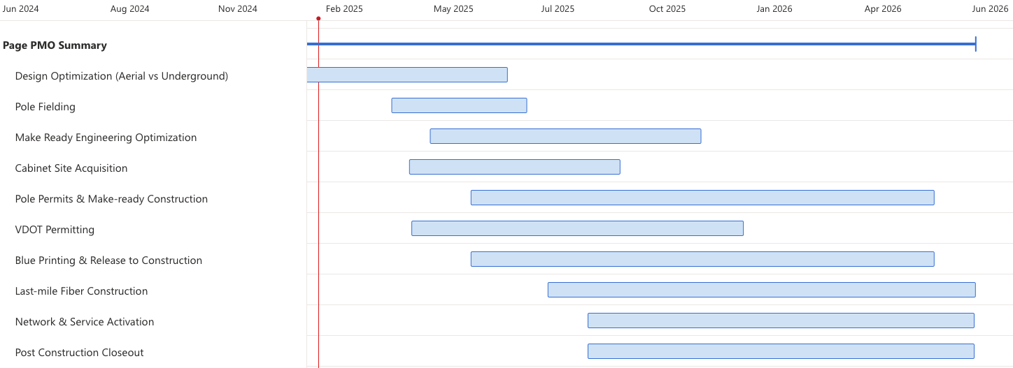
Overall Schedule Summary - Page
Construction to begin mid Q3 2025, and complete end of Q2 2026
Approximately 10-12 miles constructed per month
Close collaboration with VDOT to maintain high permit volume

Slide 5
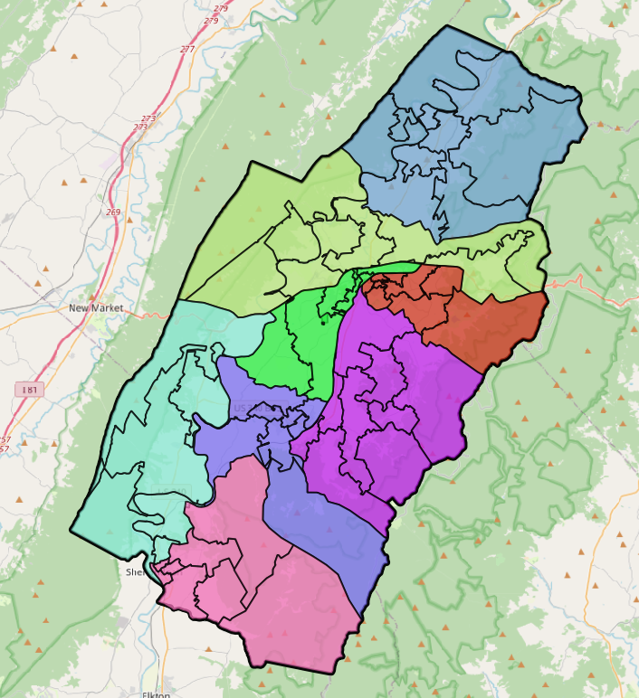

FSA/FDA Layout to be Finalized Prior to Construction
Network activation beginning in September 2025 with service available to locations on a rolling basis through June 2026 by Fiber Service Area / Fiber Distribution Area
Preregister at APBfiber.com for notifications approximately 60 days prior to service

Slide 6
Overview of Virginia’s Implementation of BEAD (Infrastructure Act)
Virginia has been allocated $1.48 billion in federal BEAD funds to serve ~130,000 BEAD-eligible locations
Shifted locations are included in BEAD as planned
Federal law requires Virginia to extend broadband to all BEAD locations
Virginia’s BEAD program opened on December 1st with applications due March 1st
APB is obligated to seek BEAD funding in all ZCTAs that include locations shifted to BEAD from the VATI project
These locations are already included in project design
APB will provide template for letter of support to include with application
APB’s BEAD applications will also include locations that were not eligible for VATI funding but are now eligible under BEAD’s new service definitions
DHCD is actively updating program guidelines:
https://www.dhcd.virginia.gov/bead
BEAD-eligible list for Mar 1st application cannot be expanded; however, DHCD will continue efforts to close digital divide, so mapping data remains critical

Slide 7
Thank You

Slide 8
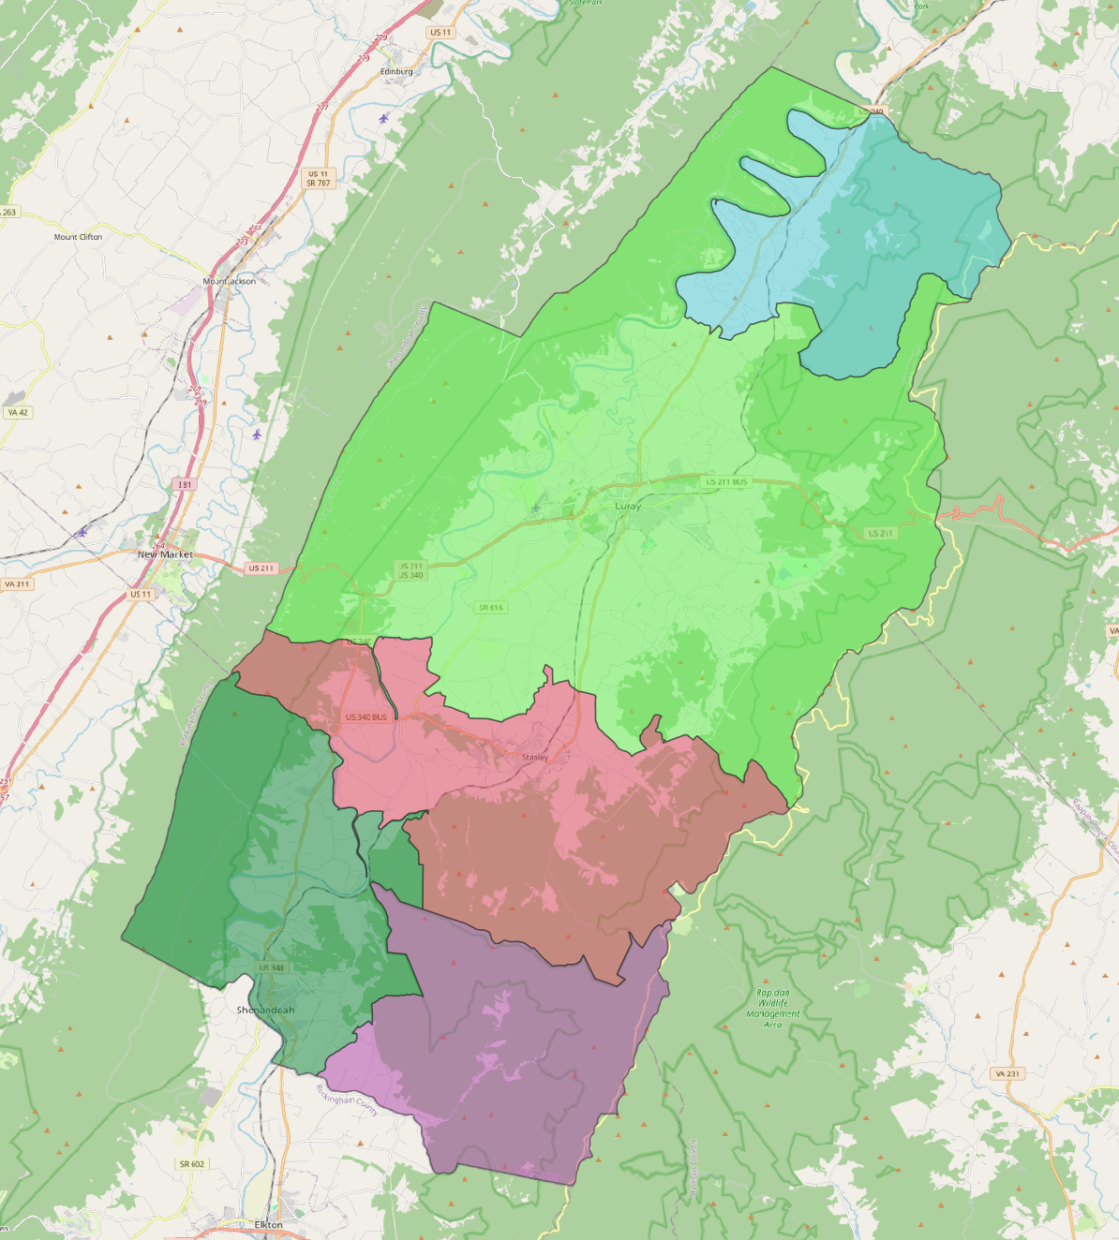
BEAD Application Areas (ZCTAs) in Page County

Slide 9
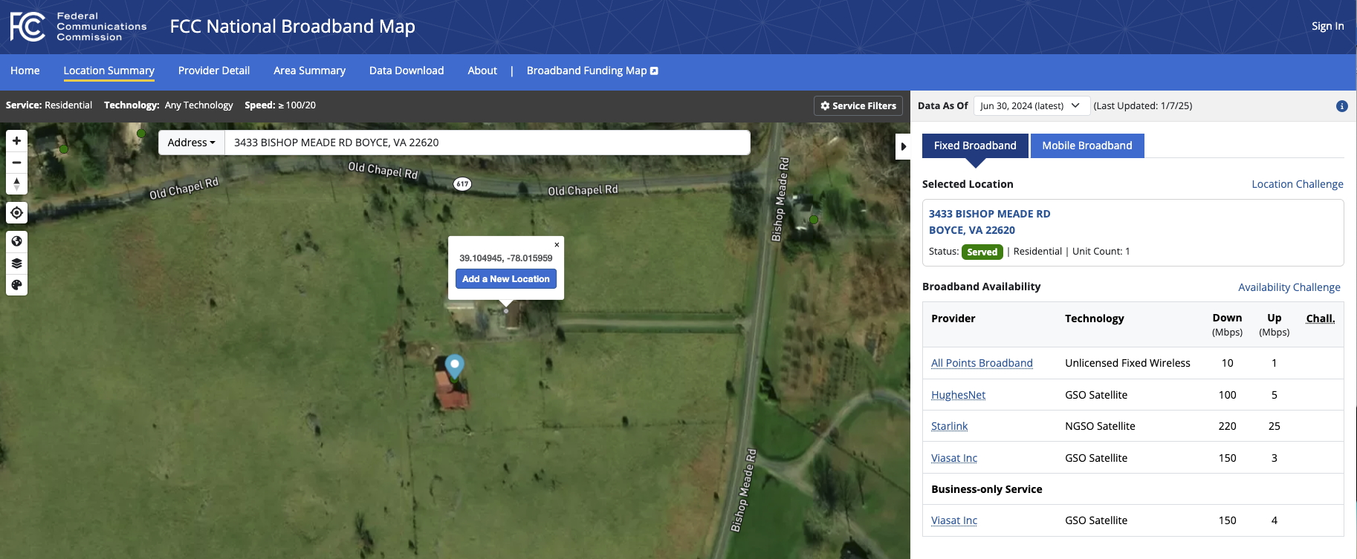
Adding or Modifying Locations through the National Broadband Map (https://broadbandmap.fcc.gov/)
Modify: Click on map icon for your location to begin “Location Challenge” process
Add: Navigate to your location and click on screen above building
to begin “Add a New Location” process

