Slide 1
All Points Broadband
---
Page County Broadband Update
^{December 1, 2025}

Slide 2
Broadband Project Overall Status
APB service expected to begin in Page in 2nd quarter of 2026
  1st of 4 network cabinets constructed; pending upstream service activation in February
  VDOT land use permit approval and SVEC pole attachment approval continue to determine critical path progress
VDOT land use permit status
  Strong, collaborative relationship with Harrisonburg residency; volume of permit applications, oversight, and inspection are significant burden
  Initial application submitted in August and awaiting approval or request to revise & resubmit; currently have 22 miles worth of fiber routes pending approval (out of 116 total underground miles)
  APB crews will mobilize to areas with approved permits following utility locate clearance, approximately 10 days from permit approval
SVEC pole attachment application have begun to be submitted
  APB’s network redesign limited attachments to approximately 2600 poles for 59 miles of aerial fiber construction

Slide 3
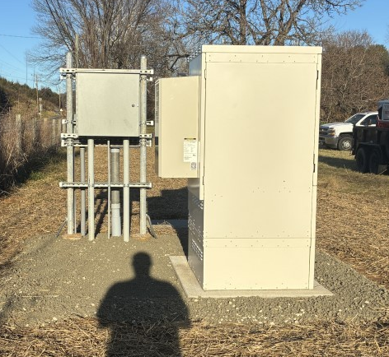
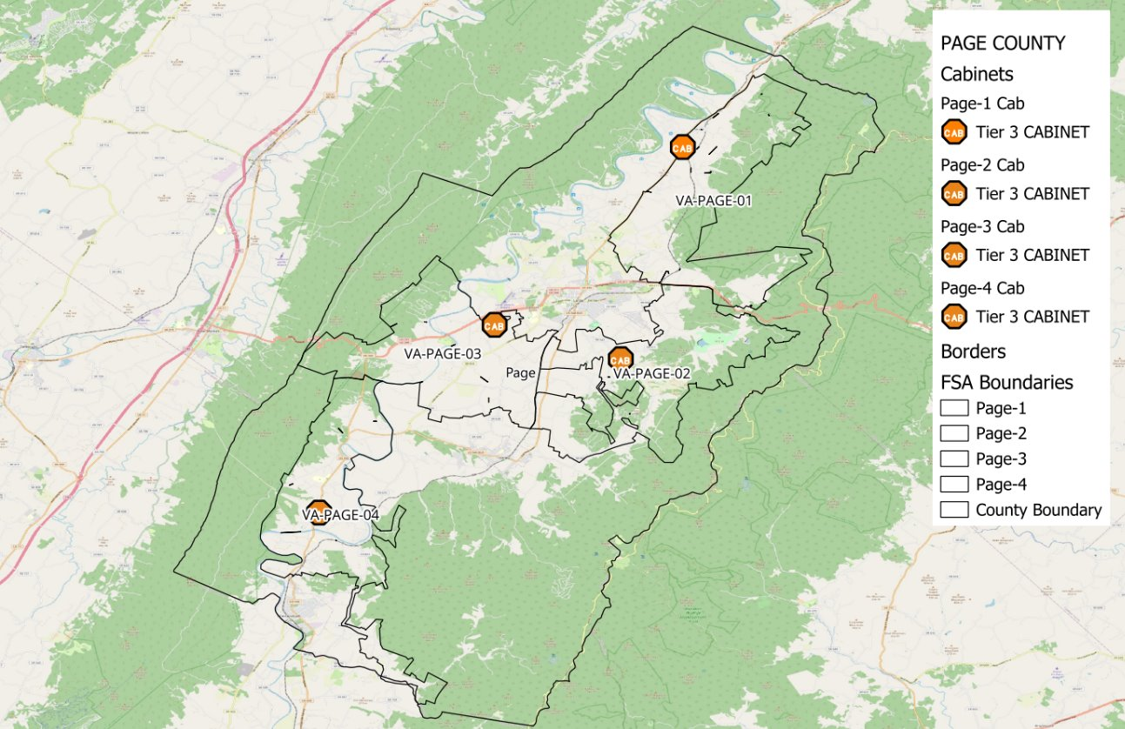
PAGE-1 Cabinet Construction
Power installed by SVEC
Backhaul from Comcast est. mid-February
All cabinets connected by March

Slide 4

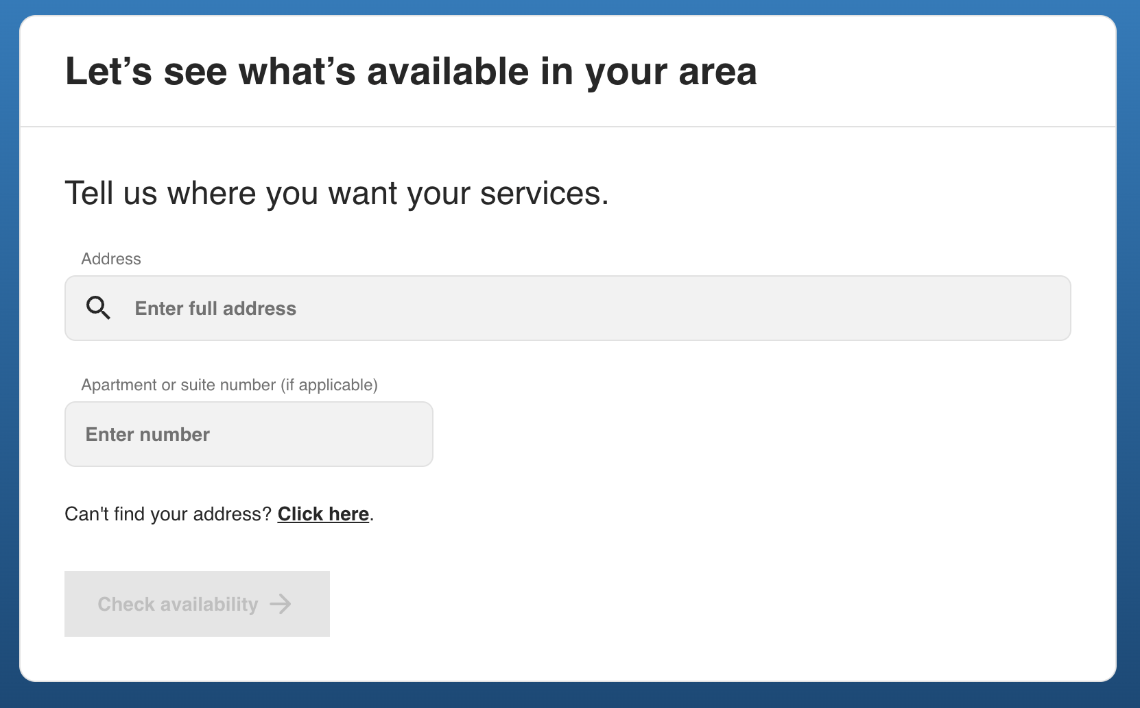
Register for Notifications – APBfiber.com

Slide 5
Thank You

Slide 6
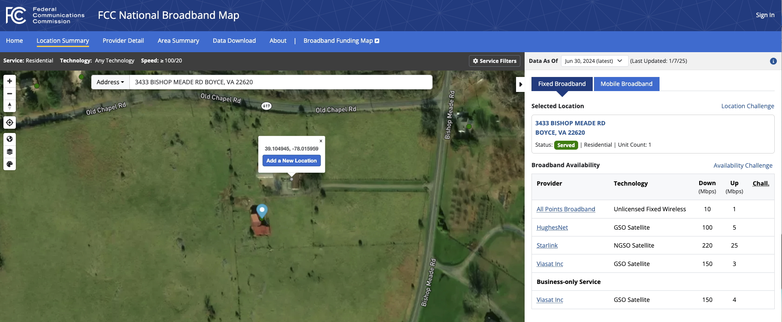
Adding or Modifying Locations through the National Broadband Map (https://broadbandmap.fcc.gov/)
Modify: Click on map icon for your location to begin “Location Challenge” process
Add: Navigate to your location and click on screen above building
to begin “Add a New Location” process

